Slide 1
Hello
there?

Slide 2
Branding & Advertising: Innovations
Notes:
Branding & Advertising: Innovations

Slide 3
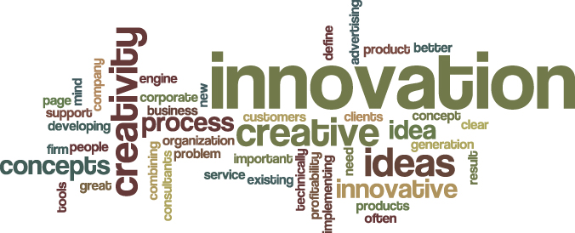
Notes:
Can anybody tell me what “innovation” means? Does something have to be “larger than life” to be an innovation? Or is it a eureka moment that somebody might have while sipping whiskey? Is getting a social networking site, or creating a product that stores all your music, videos and allows you to make calls, innovation? Can it be something that professionals sitting on a laptop achieve on a daily basis? Let’s just get the definition of innovation , right? For me, innovation is a breakthrough that is achieved to solve a business problem and has a long-term impact on the way business is perceived. For instance, how do you get the CIO community to listen to an offshore vendor on saving costs and defining how IT can work for business. Tough call, but possible.

Slide 4
Ideas
emerge everyday.
One of them may just end up being an innovation.
Notes:
In today’s dynamic environment, where change is a constant whether it’s business, technology or people, we need to push IDEAS everyday into every available opportunity. Many of you might have seen the movie “Guru”. In that movie, Gurukant Desai mentions that “hamne apni taang ada di hai”. That’s pretty much the way I look at pushing ideas into every possible opportunity because you never know which one will blossom into an innovation. If we don’t do that, an idea will always remain an idea. I’m going to show you a video where Kodak in the late 80’s wants to introduce the “slide projector” – a revolutionary new way of looking at albums. And it wants its agency to include the rotating wheel into the product packaging, so people can associate it with the turning wheel.

Slide 5
Mad Men: The Carousel

Slide 6
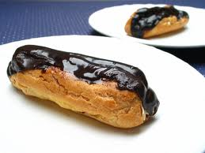
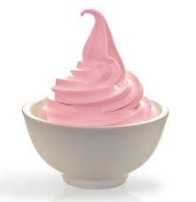
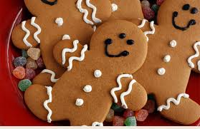
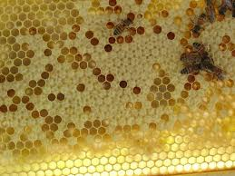
Notes:
Now, can anyone in this room guess what these images mean? Let me give you a hint – they are a revolution in the making and comprise of forty per cent of the global telecom marketplace along with iPhone – Android. 4 years back their market share was zero per cent. See how the promise of the Android OS is delivered with every version update and there is a flurry amongst users across the world to download the next most compatible OS for their hardware!

Slide 7
The power/ recall of the brand is in the promise that it has already delivered.

Slide 8
What is the key to derive holistic and meaningful communication?
Look at each artifact of your communication kit like a
print advert

Slide 9
Principles of branding
Context
Identity
Positioning
Proposition
Content/ Creative
Notes:
I rely on a very simple framework and I keep simplifying it every time I apply it.

Slide 10
Identity
PICTURE OF SENDER
Physique
Personality
EXTERNALIZATION
INTERNALISATION
Relationship
Culture
Reflection
Self Image
PICTURE OF RECIPIENT

Slide 11
Positioning
Target
Audience
Point of Difference
Frame of Reference

Slide 12
Proposition
Consumers buy benefits – Not brands
I don’t know that you offer the benefit
Awareness/ salience problem
I don’t want the benefit you offer
Who needs it?
Where is the consumer’s need gap and when is it important?
How do we make the benefit extremely desirable?
Where is it failing today?
I don’t believe that you deliver the benefit
Why do we lack credibility?
Do consumers have trouble understanding how the brand works?
Are reasons to believe not strong enough?
I already got the benefit
Can we make the consumer re evaluate – change the rules?
What is the current standards of excellence?
How do we raise the bar?
How do we substantiate?

Slide 13
Content/ Creative
Creative Execution
Media Execution
Copy Strategy
Rules of Advertising

Slide 14
In this maze of facts, do not miss out on the essential rules:
Simplicity: Keep it very simple. Works like magic
Take risks: Brave enough for something new that hasn’t been said before
Relevance: Keep it real – ensure the promise is delivered
Cohesiveness: Ensure the piece comes across as one unit – a true marriage of design and copy
Brand: Must represent the values of your brand
Notes:
Keep pushing ideas

Slide 15
Context over Dogma

Slide 16
Thank you for your time. Please feel free to reach out to me, in case you have any queries.
Mukund Arora Twitter: #Mukmaestro Mobile: +91 974 197 7533 Email: mukmaestro@gmail.com
Notes:
Please feel free to reach out to me. My co-ordinates are as follows. Thank You.

